Slide 1
Comparing Micro-Macro Dynamics and Control Across Social-like Systems Using Equation Free Modeling
James R. Watson
DARPA YFA 2017-2019
Assistant Professor, Oregon State University
email: jrwatson@coas.oregonstate.edu
web: jwatson.ceoas.oregonstate.edu/

Slide 2
Summary
Overarching Goal: Identify general and recurring micro-macro dynamics across social-like systems, focusing on new early-warning signals (EWSs) of multiscale change.
Objective: 1) Develop new mathematical framework for learning micro-scale interactions and mapping them to macro-scale dynamics; 2) Test utility beyond the state of the art
Statement Of Work (SOW), Milestones M1-6:
M1 (get data)
M2 (advance and perform new Manifold / Geometric Data Learning methods)
M3 (develop multi-scale models of social like systems)
M4 (experiment, test performance relative to state of the art, and develop new EWSs/prediction)
M5 (identify computational limits and provide fast approximations)
M6 (develop new methods of control, expand applications)
Year 1
Observe in new ways
Year 2
Model &
Experiment
Year 3
Learn &
Improve

Slide 3
Year 1 - Observe in new ways
Goal: Observe multiscale phenomena in social-like systems in new ways: through manifold / geometric data learning
Objectives: Advance new methods from manifold and geometric learning for examining multi-scale patterns in social-like systems, starting with cutting edge techniques — diffusion maps and spectral graph wavelets.
SOW: Achieve the following milestones: M1 (get data); M2 (advance and perform new Manifold / Geometric Data Learning methods); start M3 (start modeling social like systems)
Expenditures: Hired 2 post-docs, bought laptops and a server, traveled to DC numerous times, hosted collaborators from Princeton and Japan for hackathons and made DoD site-visits.
>10% underspent: we are ~9% underspent as it took time to hire the right post-docs. Now we are spending at the expected rate and are on track.

Slide 4
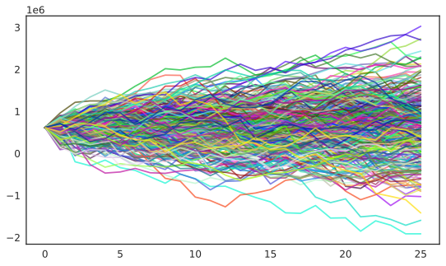
Year 1 - Observe in new ways
Accomplishments:
Synthesized all data for social-like system case-studies (and more)
Developed new use of diffusion maps with application to collective behavior in fish (paper in review at PNAS) and financial markets
New advance to spectral graph wavelets with application to human mobility data (paper in review at PNAS)
Mathematical advances for new methods for multi-scale analysis: wavelet maps (one math preprint published, another on the way)
Developed another new use of diffusion maps with application to predicting El nino and housing market crashes (2 paper in prep)
New multi-scale observational capabilities
New observational methods in general:
e) repeat over time and anticipate large change
a) get data
b) construct graph
c) perform manifold learning
d) examine shape
Notes:
Methods in a nutshell
a) Collect (timeseries) data on the micro-scale agents comprising the social-like system of interest; b) construct graph representations of the interactions between agents from these data; c) perform manifold learning using methods like diffusion maps or spectral graph wavelets; d) summarize the *shape* of your data; e) repeat this as new data comes online, doing so provides early warning of large and abrupt regime change.
Transition and broader impacts
Connections have been built to numerous new collaborators: USC ISI, NGS2, A-teams, SPAWAR
I have obtained additional funding from NASA to implement YFA tools for predicting illegal activities at sea ($860K, 3-years)
I have started a company: The Prediction Lab LLC, for applying these new methods for real-world problem solving. Currently we are doing so for the City of Salem OR, for predicting harmful algal blooms in the source of their drinking water.

Slide 5
Year 2 - Model and Experiment
Yr2 Goals:
New observational abilities gained; now we are in the process learning why we see what we do through the lens of geometry
Testing against state of the art
Objectives:
Test utility of new geometric methods, in comparison to state of the art techniques (machine learning, Taken’s based prediction, Topological Data Analysis…etc).
Develop model of social-like systems to link geometric patterns to generative mechanisms driving multiscale change
Continue to apply new data analytic tools to empirical datasets to maximize research output (i.e. numerous papers are lined up)

Slide 6
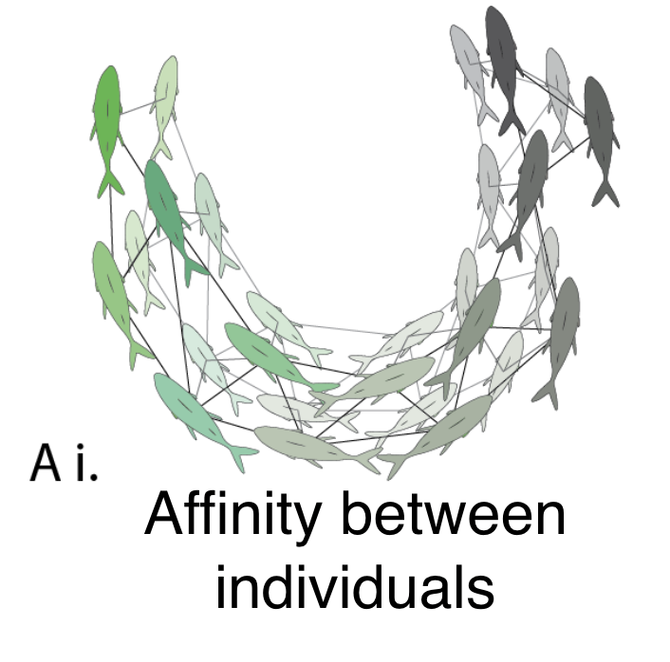
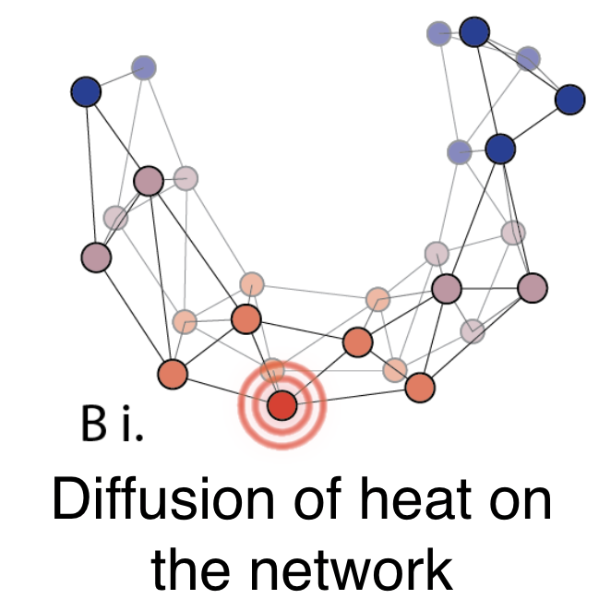
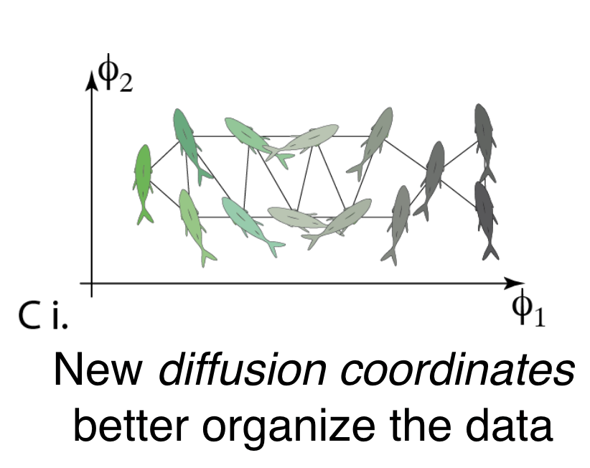
Year 2 - Model and Experiment
Core Anticipated products:
New multi-scale early-warning signal framework (wavelet maps) to identify and measure influence of leaders (and their followers) in collectives
Performance metrics of new early-warning signals for anticipating change in complex social systems (compared to state of the art approaches)
Example application of new geometric methods to fish collective behavior reveals: a) hidden micro-scale interactions and b) early-warning signals of macro-scale change

Slide 7
Year 3 - Learn and Improve
Observe in new ways
Model &
Experiment
Learn &
Improve
Year 1
Year 2
Year 3
SOW (at the full cost of $392,381 for year 3)
Complete modeling and experimentation to
verify generality of new geometric multi-scale methods for improved understanding of complex social-like system
Measure performance of new early-warning signals relative to state of the art (e.g. machine learning, Topological Data Analysis)
Develop new methods for controlling social-like system: can geometric representations of social-like systems aid in the design of approaches that *nudge* systems to different states?
Identify computational limits and fast approximations: our new geometric methods can be computationally demanding, which is a bottle neck for transition. To overcome this we will rigorously determine its scalability.
Notes:
Key insight/innovation, scientific/technical impact:
Control: by learning how to control social-like systems through small nudges, we will also be able to identify when a social-like systems is being controlled (by an adversary)
Uncertainty: posing our geometric prediction methods in a Bayesian framework will give us explicit bounds on our forecast abilities, and as a consequence allow us to estimate risk, a crucial step for transition

Slide 8
Year 3 - Learn and Improve
Relation to original goals:
Without year 3, this project’s results will remain specific to the empirical case studies analyzed. Further, important benchmarks that measure the performance of our new approach relative to the state of the art, will only be partially achieved, limiting the generality of the findings.
Yr3 is key to confirming the generality of our new geometric EWSs and their utility for transition to DoD applications.
Potential defense application(s):
Predicting illegal activities at sea (new 3yr project underway funded by NASA and in collaboration with the Navy; early results indicate immediate utility)
Aid in the design, management and destruction of collectives (proposal to DSO BAA)
Early-warning signals of innovation by terrorist groups (informing DARPA SIGMA+).
Predicting patterns of human migration (submitting proposal to MINERVA program)
Potential concerns: 1) identifying and employing the state of the art (by which to measure relative performance) is a substantial work package; 2) controlling complex social systems through nudges requires new theory.
Risk mitigation: the state of the art will be broken into doable modules, focusing first on Topological Data Analysis (this approach is most similar to our new methods); the mathematical theory developed in yr2 will serve as a platform for developing approaches to nudging systems

Slide 9
YFA Products to Date
Publications
Monk, Christopher T., et al (including Watson JR as a co-lead author). "How ecology shapes exploitation: a framework to predict the behavioural response of human and animal foragers along exploration–exploitation trade‐offs." Ecology letters 21.6 (2018): 779-793.
Gelbaum et al. “Multi-Scale Analysis on Complex Networks using Hermitian Graph Wavelets”, ArXiv Pending*.
Titus et al. “System Rattle as an Early Warning Signal of Regime Change in Complex Systems”, ArXiv Pending*.
Publications in review:
Watson et al. “Manifold Learning of the Dominant Modes of Human Mobility”. PNAS (in review)
Titus et al. “Unsupervised Manifold Learning of Collective Behavior”. PNAS (in review)
Commercialization:
The Prediction Lab LLC (a technical consultancy that employs these new DARPA methods: secured contract with the City of Salem to predict harmful algal blooms in the source of their drinking water)
Highest ranked ecology journal
Mathematical preprints
Main year 1 deliverables
Broader Impacts
Notes:
*Note about ArXiv publications… they were submitted Monday 21st 2019, and will be online and active with a DOI on Wed Jan 23rd. I will send an updated ppt with links then.

